Slide 1


Cyber-security Considerations for Safety Critical Systems
From
Team 16
Paul Earhart, Haoran Geng,
Dustin Kline, Larry Kozlowski, Daniel Moreno

Slide 2
Presentation Overview
Introduction
Features and stakeholders
Our solution
Three systems
CAN-BUS encryption
System failure mode analysis
Budget
Going Further Material
Conclusion

Slide 3
Introduction:
The Controller Area Network (CAN bus)
Testing and documenting the inherent cyber-security of a CAN bus
Demonstrate everything that was learned about CAN bus cyber-security

Slide 4
Our features
Feature Name | Feature Definition
Safety | Research directly aids in safety and protection of all stakeholders
Security | Research directly aids in security by blocking or interrupting third party attacks
Affordability | Solution is low cost as to not lower margins
COTS | Solution is readily available and made with consumer-off-the-shelf components
Maintainable | Solution is easy repaired and replaced by technicians
Manufacturability | Solution is easily installed and uses existing technologies to create

Slide 5
Our stakeholders
Stakeholder Name | Level of Importance | Description
Rolls-Royce | Highest | The company supporting the research
Supervisor | Moderate | The faculty member overseeing the project
Manufacturer | Moderate | Company manufacturing and assembling vehicles
Clients | Highest | Customers buying RR products
Consumers | Lowest | Customers buying Client products

Slide 6
Level of Importance
 |  |  | Stakeholders
Feature | ID | Attribute/Metric | RR | Supervisor | Manufacturer | Clients | Consumers
Safety | A1 | User Inputs | 1 | 1 | 0 | 1 | 1
 | A2 | ECU Management | 1 | 1 | 0 | 1 | 0
 | A3 | Safety Control Systems | 2 | 2 | 1 | 2 | 0
Security | B1 | Attack Bypass Measure | 1 | 1 | 1 | 1 | 1
 | B2 | Attack Interrupt Measure | 1 | 1 | 1 | 1 | 1
COTS | C1 | Built with Arduino | 1 | 0 | 0 | 0 | 0
 | C2 | Built with Beagle Bone | 1 | 0 | 0 | 0 | 0
 | C3 | OBDII Compatible | 1 | 0 | 1 | 1 | 1
Manufacturability | D1 | Easily Installed | 0 | 0 | 1 | 1 | 0
 |  | Totals | 9 | 6 | 5 | 8 | 4

Slide 7
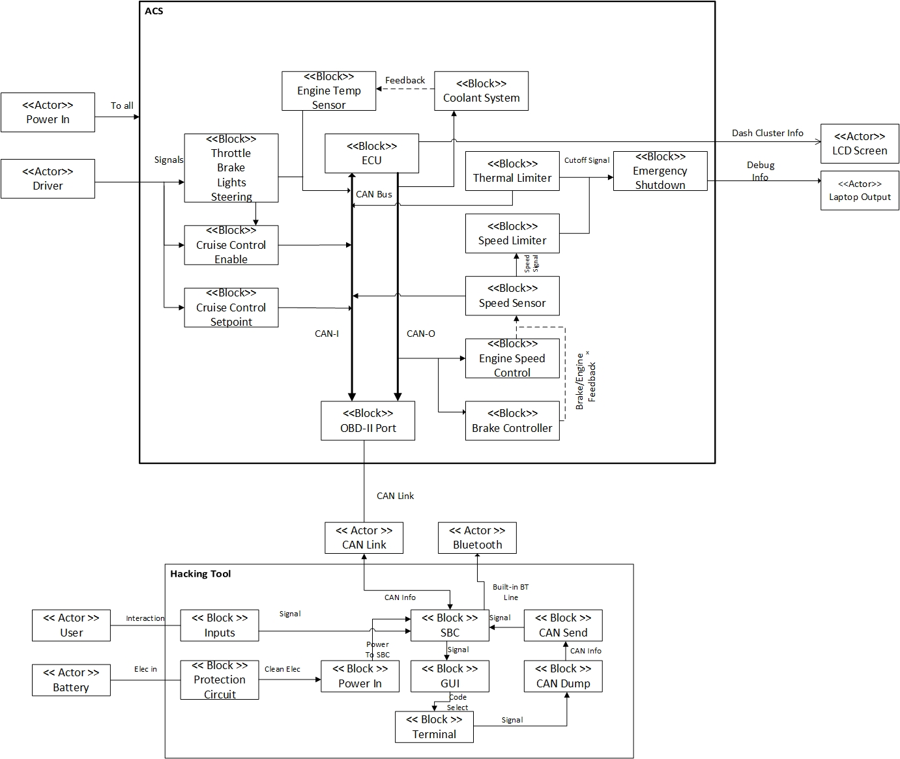
Our solution
Base System
Attack System
Hardened System

Slide 8
Project deliverables
all design and technical documentation
a fully functioning, closed system, demonstration that includes but is not limited to
Three attacks models based on baud rate manipulation, id replication, and denial of service
Three defence models based on state prediction, redundant networks, and per-node correction.
a user manual for the demonstration system
a white paper documenting our findings and resulting recommended hardening steps

Slide 9
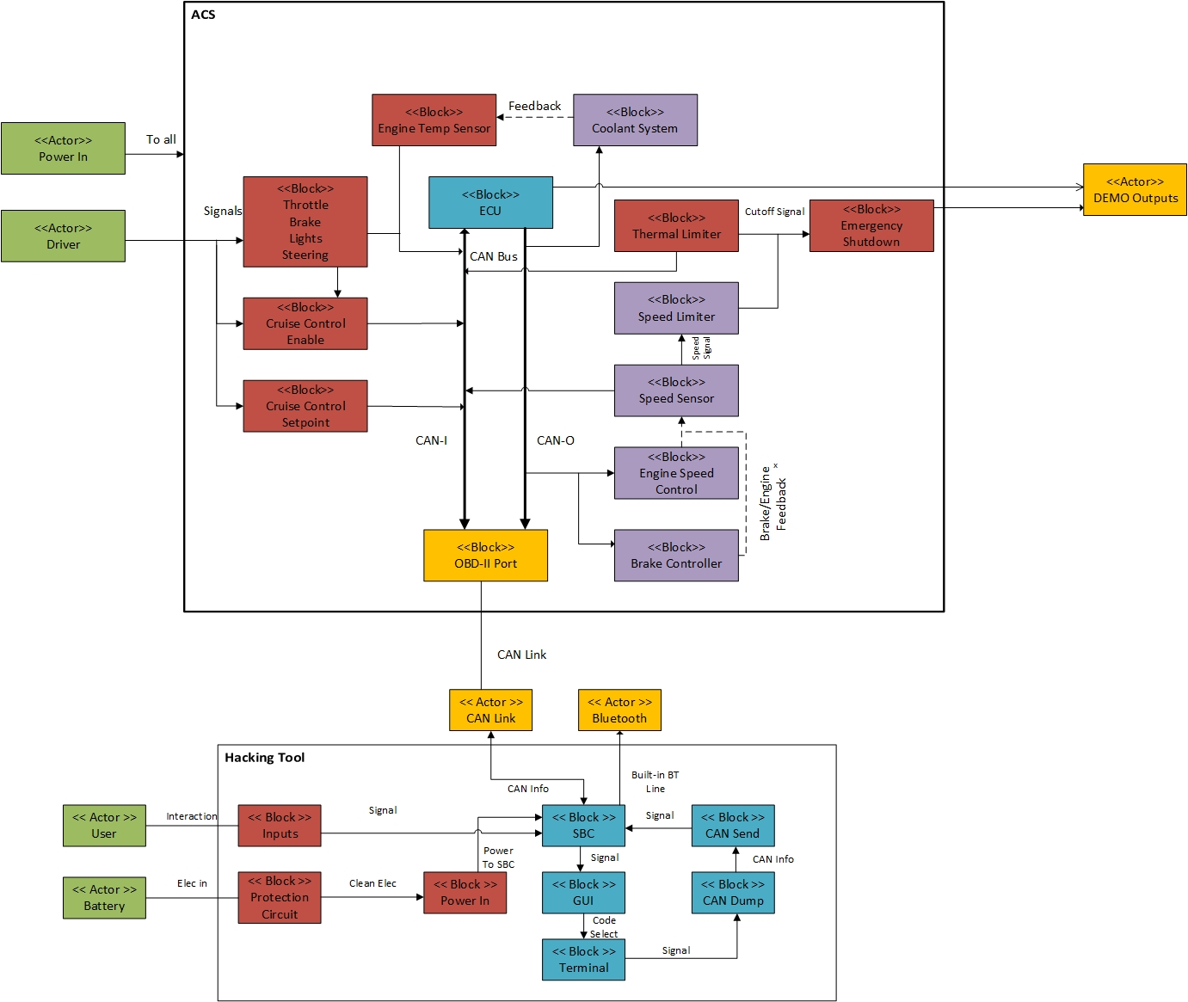
Base System

Slide 10
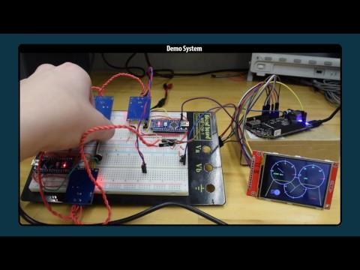

Slide 11
Attack System

Slide 12
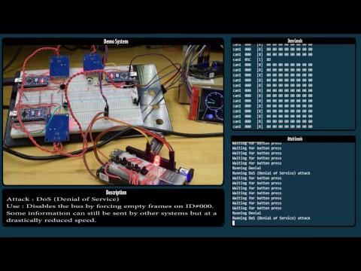

Slide 14
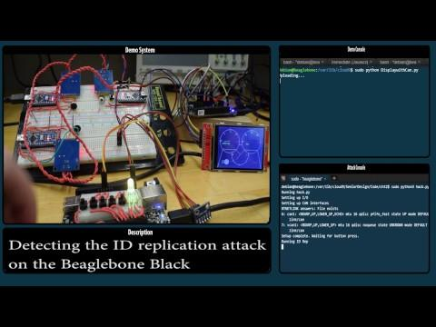
Hardened System

Slide 15
CAN-BUS Encryption
Inheriting the knowledge gained by Team 16, research possible implementations of CAN-BUS encryption.
Design goals:
Make it impossible for some external entity to successfully impersonate one of the nodes in the BUS.
Protect the confidentiality of messages sent through the BUS.
Minimize the hit to performance done by the encryption techniques.

Slide 16

Quick encryption, how?
My plaintext is of a mere 64 bit!
Symmetric encryption:
PROS: Lightweight algorithms, small payloads. (still some of them were too big)
CONS: One key, anyone who possess it can encrypt and decrypt. Same key shouldn’t be
used more than once.
Asymmetric encryption:
PROS: Two keys, one to encrypt another to decrypt, provides identity.
CONS: Computationally intensive, big payloads.
Hashing (data digestion):
PROS: Provides authentication. I can show knowledge of something without leaking it.
CONS: No actual info can be transmitted, most of them are still too big for my payload.

Slide 17
The biggest challenge:
Key agreement
Design 1: Implement CAN-CHAP (Challenge-Handshake Authentication Protocol)
Drawbacks: harder to implement.
Pros: very fast
Design 2: Public-Key Cryptography.
Drawbacks: slow
Pros: standard practice, safe, relatively simple to implement.

Slide 18
Design 1:
CAN-CHAP Tools
Symmetric encryption: ChaCha20
Key length: 256 bit
Nonce: 64 bit
Counter: 64 bit
Extensible payload (1-512 bit)
Hash: Blake2s
Extensible payload (0-256 bit)
Keyed-Hash: SipHash
Key length: 128 bit
Payload: 64 bit (Just right)
THESE ALL ARE IMPLEMENTED AT SOFTWARE LEVEL!

Slide 19
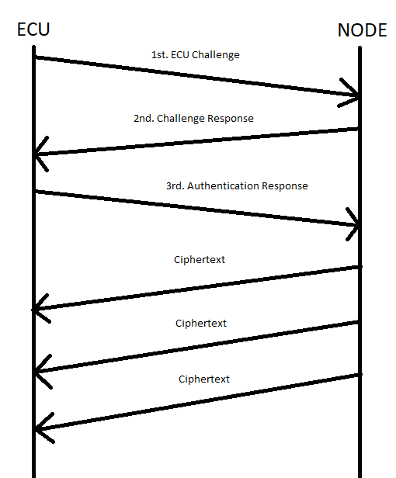
CAN-CHAP Implementation
ECU sends a 64 bit random through BUS (1st)
NODE receives message
Calculates s1 = SipHash(Challenge)
Calculates s2 = SipHash(S1 + Node ID)
Sends s1 through BUS (2nd)
ECU receives message
Calculate s1 = SipHash(Challenge + Node ID)
Verifies s1 value
Calculates s2 = SipHash(s1)
Sends s2 (3rd)
Readies ChaCha20 for receiving
NODE receives message
Verifies s2
Initializes ChaCha20
Readies ChaCha20 for sending
Sends ciphertext

Slide 20
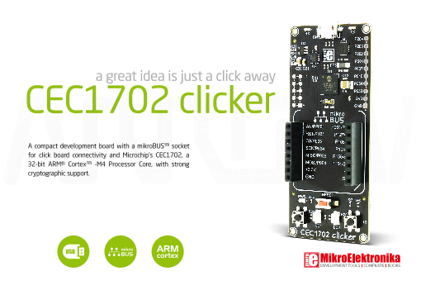
Design 1
Clifnotes
Software implementation is way too slow (200 ms at the lowest)
Currently searching for external dedicated hardware to carry the computational load:

Slide 21
Project Deliverables
A practical implementation of both of these designs.
An extensive analysis of both implementations, discussing their strong points and weak points, backed by data gathered through testing.

Slide 22
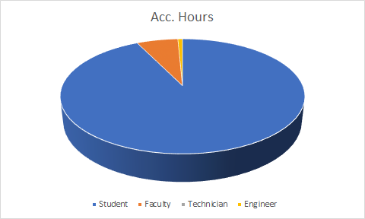
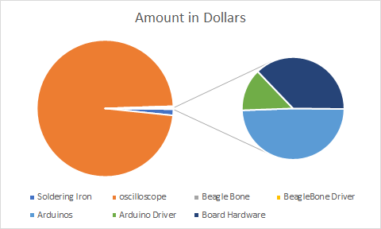
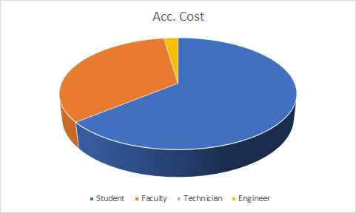
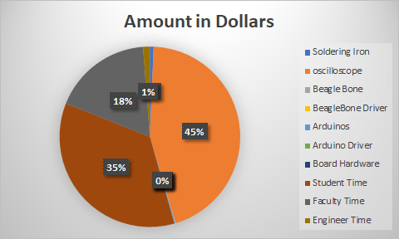
Budget

Slide 23
Going Further Material
Social Impact
Economical Impact
Environmental Impact
What we can do differently

Slide 24
Conclusion

